Slide 1
Manifold Mixup Better Representations by Interpolating Hidden States (Manifold Mixup)
Vikas Verma
Aalto University, Finland
ICML 2019
2019-07-13

Slide 2
1
Overview
Contents
Problem
Verification
Conclusion
Inspiration
Scheme
Future
Interpolation
Hidden representation
Manifold Mixup
flatten
Decision boundary
Class-representation
Keywords
Direction of variance

Slide 3
2
Problem

Slide 4
3
Inspiration

Slide 5
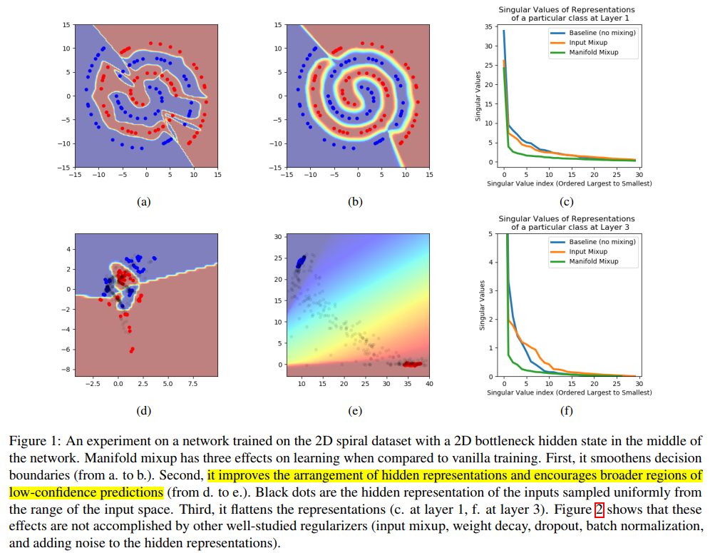
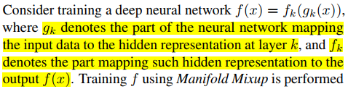
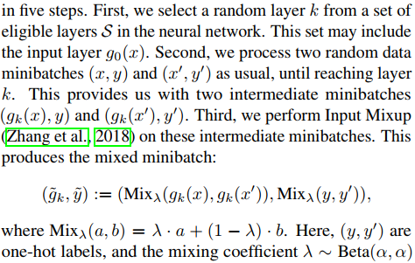
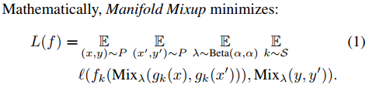
4
Scheme

Slide 6
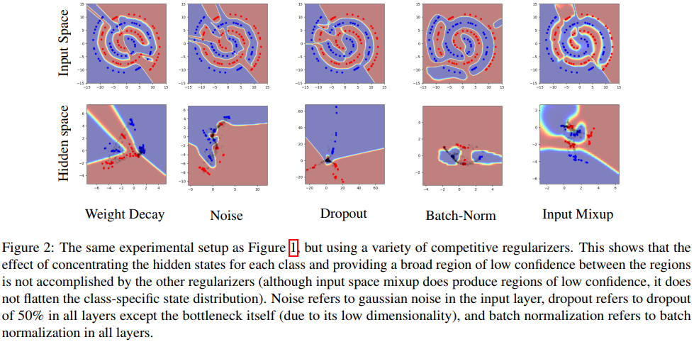
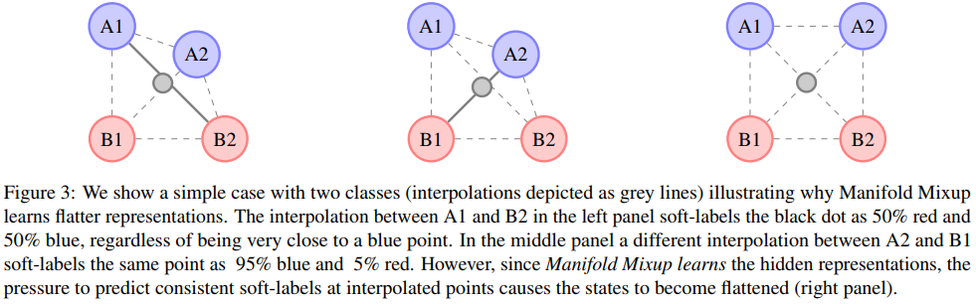
5
Verification

Slide 7
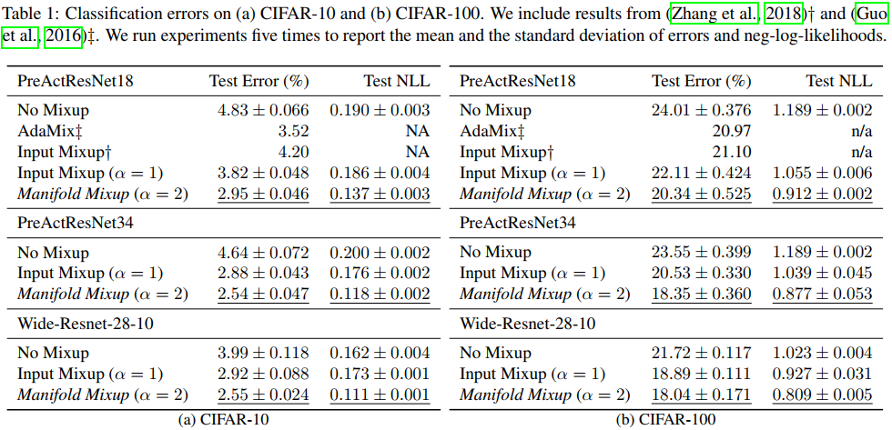
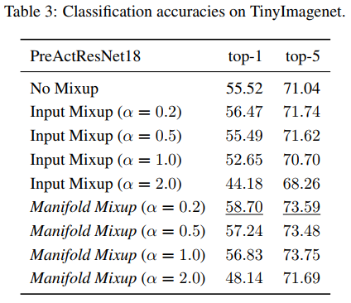
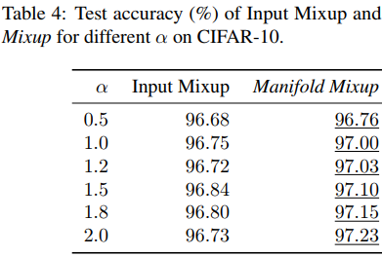
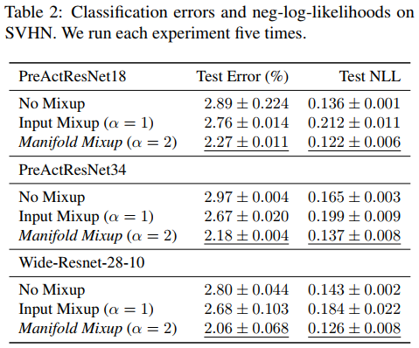
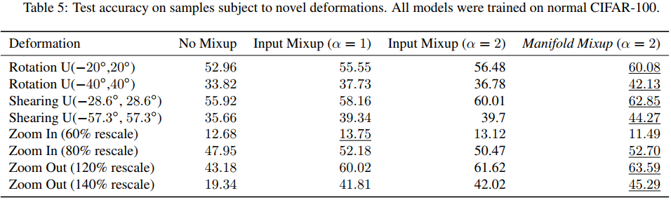
6
Empirical Results

Slide 8
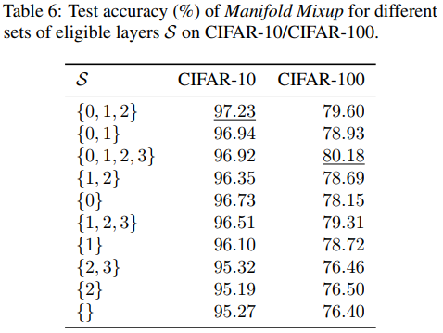
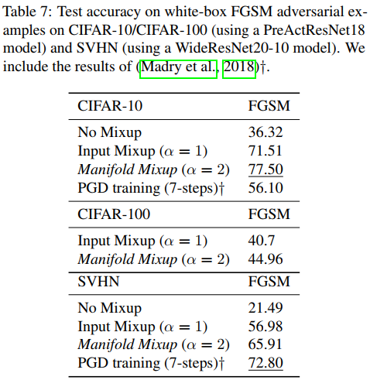
6
Empirical Results

Slide 9
7
Conclusion

Slide 10
8
Future

Slide 11
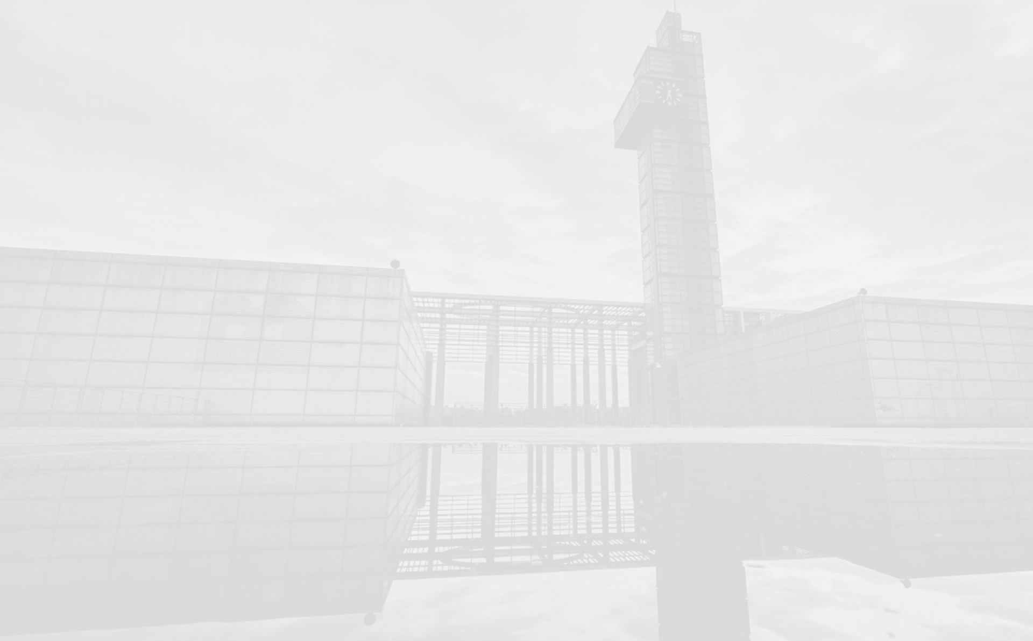


Thank you !
Mengdie Huang
Group AI Security
Lab Ruiyun
2020-10-7

